Slide 1

Lockdown Impact on Property Listings Lina Berbesi
Source: unsplash.com

Slide 2
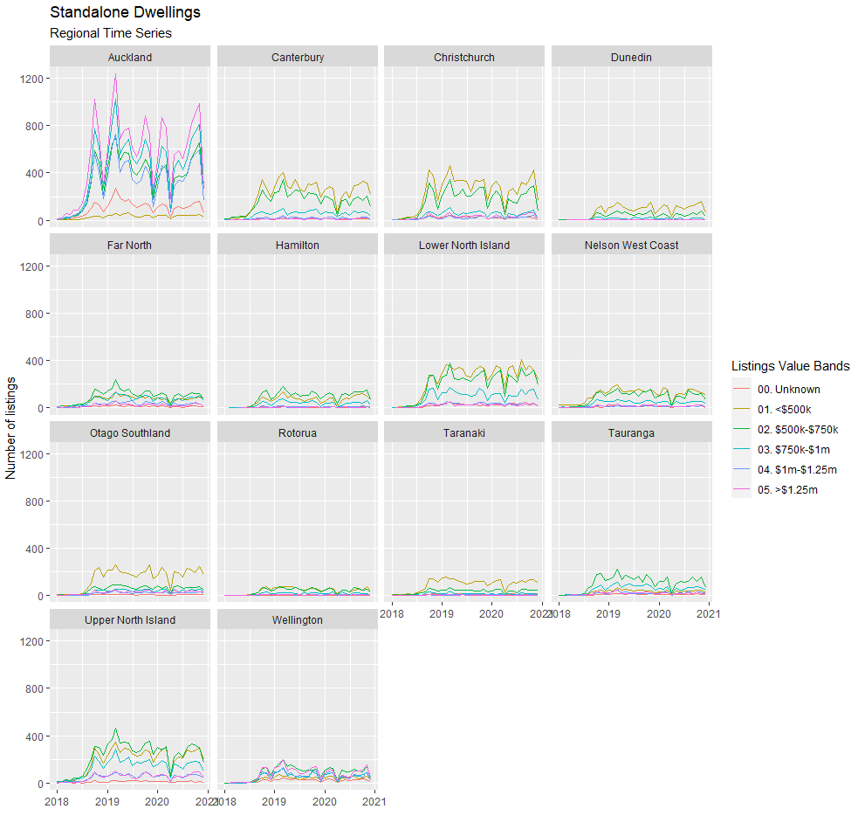
Standalone Dwellings
Standalone dwellings volume started decreasing following a downward trend just after covid restrictions were imposed on the size of gatherings and movement at the end of March 2020 (level 2).
Following this, there was a momentary lapse where all listings regardless the value plunged suddenly in April 2020 and hit their lowest point after level 3 and level 4 were announced.
By May 2020 they started picking up again to their current levels after restrictions went down to level 1 and 2 with a small fall in August 2020 after level 3 was briefly set for less than 15 days.
Low listings values in December 2020 seem to be most likely related with incomplete data rather than a change in the market trends, with their value being half of what has been historically recorded for this property type.

Slide 3
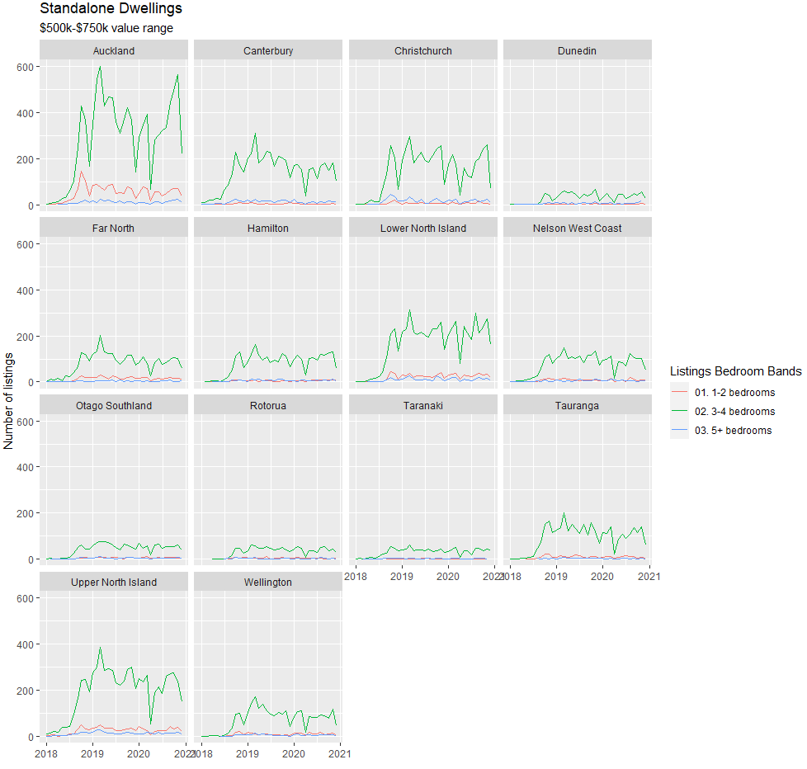
Standalone Dwellings Deep Dive
For Standalone dwellings, the region that had seen the biggest impact was Auckland. This is mainly due to Auckland’s listing volume which doubles the volume of any other region. Followed by Christchurch where listings of dwellings under $500k and between $500k and $750k went gone back to pre-covid levels at the end of 2020 after plummeting when covid restrictions were announced. Same for Upper North Island. In contrast to regions like Wellington and Lower North Island where covid restrictions seem to have had little to no impact on the listings volume.
When doing a deep dive for the standalone dwellings with a value range between $500k and $750k, it can be seen the properties that had the biggest impact around covid restrictions during 2020 were the ones of 3 to 4 rooms. Other categories ( 1 to 2 rooms and five plus rooms) volumes were too small therefore too volatile to show any marked trend.

Slide 4
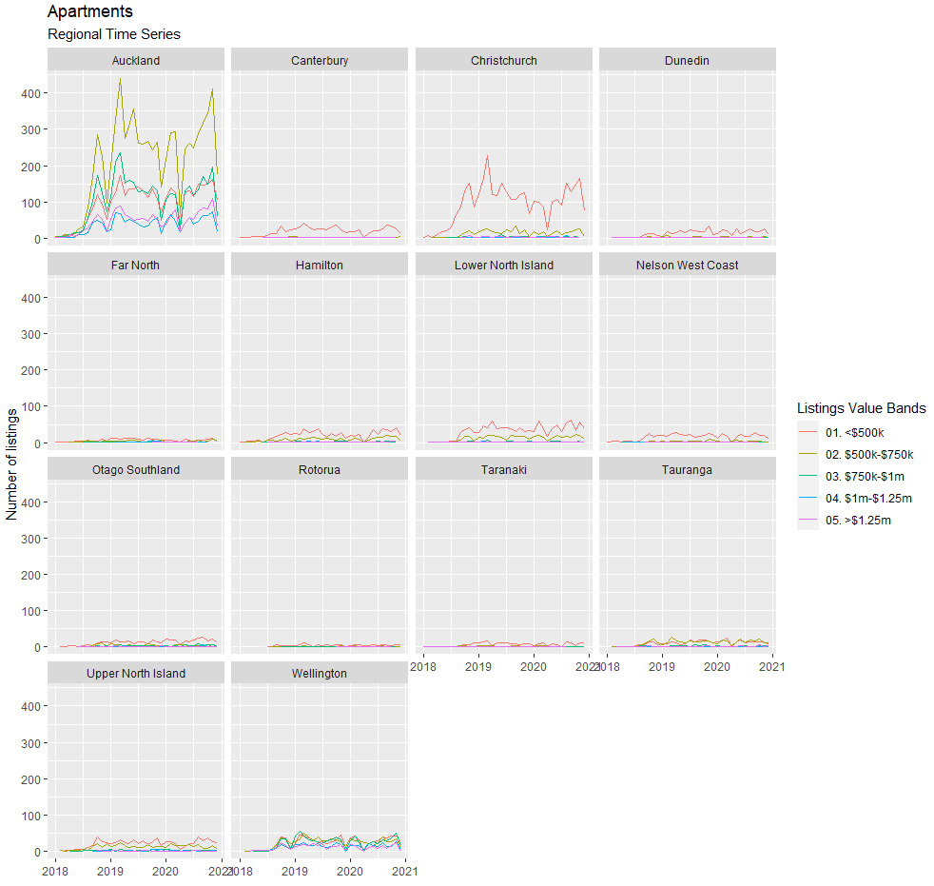
Apartments
Apartments data seems to be scarce for some regions and listings bands.
Apartments volumes were falling since April 2019 before any covid restrictions were in motion. This downward trend continued for the first half of 2020, with a plunge in April 2020 after level 4 announcement.
Minimum restrictions levels such as level 1 and level 2 appear not to have any impact on the apartments listing volumes, given that volumes started rising from May 2020 onwards after they were announced.
The same data quality issue for December 2020 seem to be present in Apartments.

Slide 5
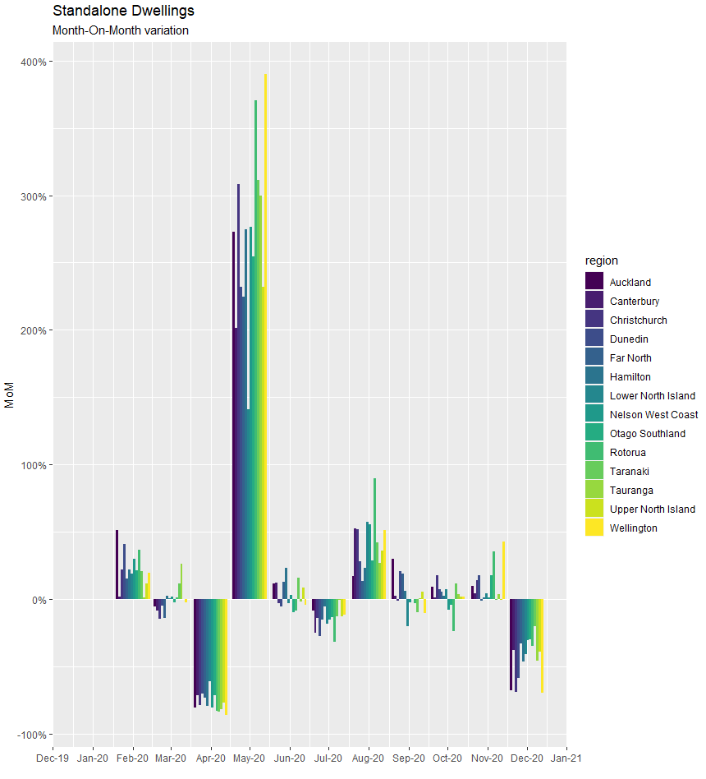
Month-On-Month Variation
Level 4
The biggest impact on the Month-on-Month variation for both Standalone Dwellings and Apartments is observed when level 4 is reached during late March and April when variations for all regions dropped to negative numbers.
Shortly afterwards in late April/ early May when level 3 is announced listings picked up rapidly which is clearly shown by a quadrupled numbers of listings when comparing with the previous month.
Other announcements of level 3 in late August and late September had little to no impact.
Level 3
Level 3

Slide 6
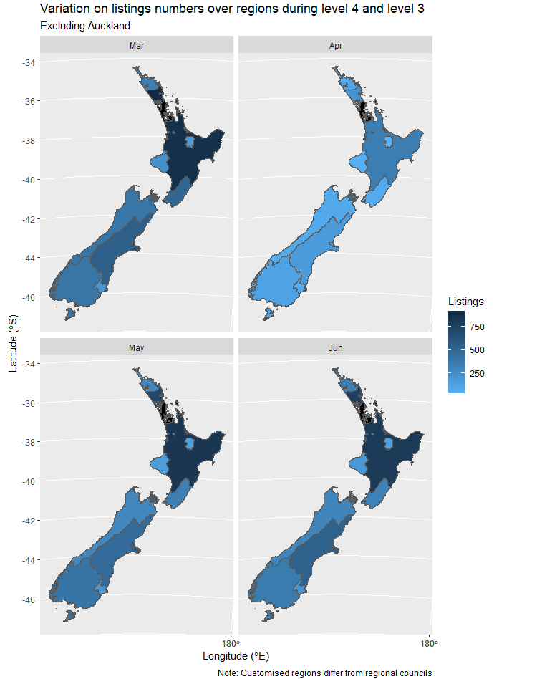
Regional variation on level 3 and 4
A choropleth map with the listing's numbers for the months of March, April, May and June shows how level four in April had the biggest impact on the properties being listed.
The regions with the highest number of listings are consistently Auckland, Upper North Island, Lower North Island and Canterbury in the South Island.

Slide 7




Conclusions
Covid lockdown had the same impact on listings numbers regardless the property type.
Small value properties listings between 500k and 750k and below 500K seemed to be more susceptible to covid lockdown levels.
Minimum restrictions levels such as level one, and level two appear not to have any impact on the apartments and standalone dwelling listing volumes.
LAT
LON
Regional listing’s variation remains constant on levels 3, 2 and 1.

